Slide 1
Secure Hash Algorithm

Slide 2
Hash Algorithms
see similarities in the evolution of hash functions & block ciphers
  increasing power of brute-force attacks
  leading to evolution in algorithms
  from DES to AES in block ciphers
  from MD4 & MD5 to SHA-1 & RIPEMD-160 in hash algorithms
likewise tend to use common iterative structure as do block ciphers

Slide 3
MD5
designed by Ronald Rivest (the R in RSA)
latest in a series of MD2, MD4
produces a 128-bit hash value
until recently was the most widely used hash algorithm
  in recent times have both brute-force & cryptanalytic concerns
specified as Internet standard RFC1321
Notes:
MD5 is the current, and very widely used, member of Rivest’s family of hash functions.

Slide 4
MD5 Overview
pad message so its length is 448 mod 512
append a 64-bit length value to message
initialise 4-word (128-bit) MD buffer (A,B,C,D)
process message in 16-word (512-bit) blocks:
  Compression function that consists of 4 rounds of processing labelled as HMD5
  using 4 rounds of 16 bit operations on message block & buffer
  Each round takes as i/p the current 512 bit block being processed(Yq) and 128bit buffer value ABCD and updates the content of the buffer
Notes:
The padded message is broken into 512-bit blocks, processed along with the buffer value using 4 rounds, and the result added to the input buffer to make the new buffer value. Repeat till run out of message, and use final buffer value as hash. nb. due to padding always have a full final block (with length in it).

Slide 5
Output of the fourth round is added to the i/p to the first round(CVq) to produce CVq+1
5.Output: After all L 512bit blocks have been processed ,the output from the Lth stage is the 128bit msg digest

Slide 6
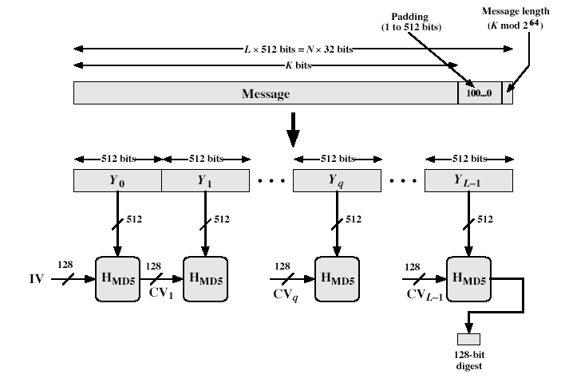
MD5 Overview
Notes:
Stallings Fig 12.1

Slide 7
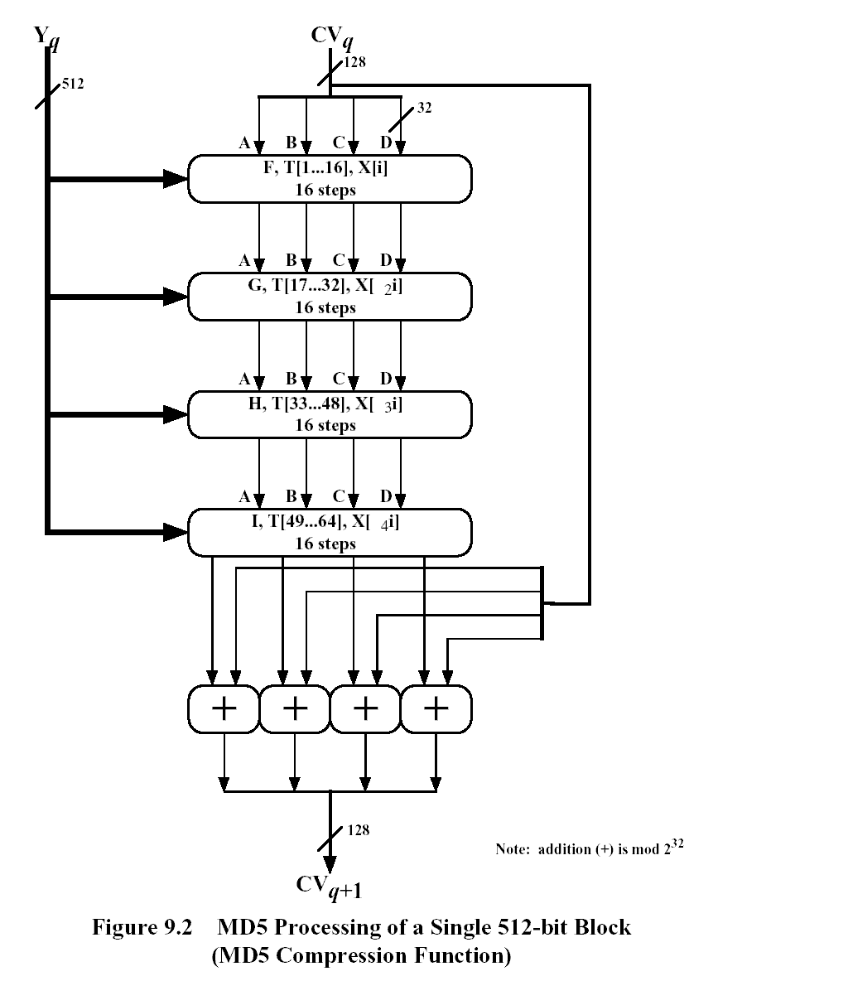

Slide 8
MD5 Compression Function
each round has 16 steps of the form:
  a = b+((a+g(b,c,d)+X[k]+T[i])<<<s)
  A,b,c,d-four words of the buffer,in a specified order
  g-one of the primitive function F,G,H ,I
  <<<s-Circular shift of 32bit argument by s bit
  T[i]-ith 32 bit in matrix T
  +-addition modulo 2³²
Notes:
Each round mixes the buffer input with the next "word" of the message in a complex, non-linear manner. A different non-linear function is used in each of the 4 rounds (but the same function for all 16 steps in a round). The 4 buffer words (a,b,c,d) are rotated from step to step so all are used and updated. g is one of the primitive functions F,G,H,I for the 4 rounds respectively. X[k] is the kth 32-bit word in the current message block. T[i] is the ith entry in the matrix of constants T. The addition of varying constants T and the use of different shifts helps ensure it is extremely difficult to compute collisions.

Slide 9
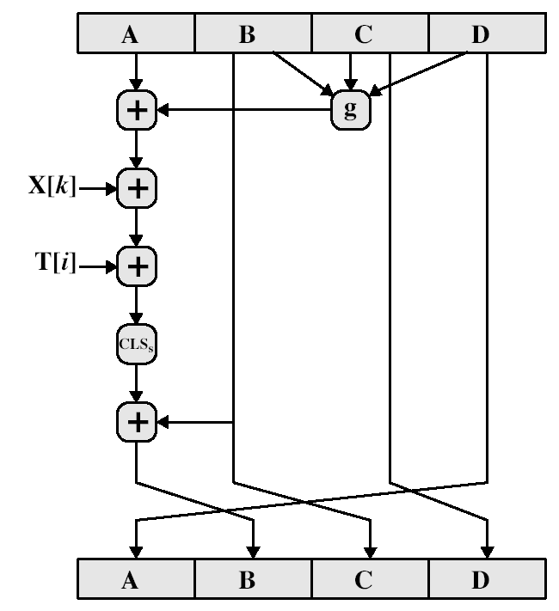
MD5 Compression Function

Slide 10
MD4
precursor to MD5
also produces a 128-bit hash of message
has 3 rounds of 16 steps vs 4 in MD5
design goals:
Security:It be computationally infeasible to find two msg’s that have the same msg digest
Speed:Algm is intended to be fast on 32 bit architecture
Notes:
MD4 is the precursor to MD5, and was widely used. It uses 3 instead of 4 rounds, and the round functions are a little simpler. In creating MD5 Rivest aimed to strengthen the algorithms by introducing the extra round, and varying the constants used.

Slide 11
Simplicity and Compactness : Algm should be simple to describe and simple to pgm
Favour little Indian architecture : Store least significant byte of a word in low-address byte position

Slide 12
Difference between MD4 and MD5
1.MD4 uses 3 rounds of 16 steps each,MD5 uses 4 rounds of 16 steps each
2.MD4,no additive constant used in first round.
second round-same additive constant is used for each step
third step-Another additive constant is used for each step
In MD5 different additive constant T[i],is used for each of the 64 steps

Slide 13
3.MD5 uses primitive logical functions, one for each round, compared to 3 for each MD4,again one for each round
4.MD5 each step adds in the result of the preceding step.MD4 did not include this

Slide 14
Strength of MD5
Every bit of the hash code is a function of every bit in the i/p
Rivest claims security is good
known attacks are:
  Berson ,using differential cryptanalysis, possible in reasonable time to find two msg’s that produce the same digest for single round. Bt he was not able to generalize attack to full round
Notes:
Some progress has been made analysing MD5, which along with the hash size of 128-bits means its starting to look too small. Hence interest in hash functions that create larger hashes.

Slide 15
  Boer & Bosselaers showed execution of MD5 on a single block of 512bits yeild the same output for two different input values in buffer ABCD->pseudocollision.
  Bt he was not able to extend this approach to a successful attack on MD5
  Dobbertin,operation of MD5 on a single 512bit block of i/p by finding another block that produces the same 128bit.He was not able to generalize it
conclusion is that MD5 looks vulnerable soon

Slide 16
Secure Hash Algorithm (SHA-1)
SHA was designed by NIST & NSA in 1993, revised 1995 as SHA-1
US standard for use with DSA signature scheme
  standard is FIPS 180-1 1995, also Internet RFC3174
  nb. the algorithm is SHA, the standard is SHS
produces 160-bit hash values
now the generally preferred hash algorithm
based on design of MD4 with key differences
Notes:
SHA is one of the newer generation of hash functions, more resistant to cryptanalysis, and now probably preferred for new applications.

Slide 17
SHA Overview
pad message so its length is 448 mod 512
append a 64-bit length value to message
initialise 5-word (160-bit) buffer (A,B,C,D,E) to
  (67452301,efcdab89,98badcfe,10325476,c3d2e1f0)
process message in 16-word (512-bit) chunks:
  Consists of four rounds of processing of 20 steps each
  Four rounds uses different primitive locgical func,f1,f2,f3,f4
  Each round takes as i/p the current 512bit block being processed(Yq) and 160bit buffer value A,B,C,D,E and updates buffer
Notes:
Note that the SHA-1 Overview is very similar to that of MD5.

Slide 18
Each round uses an additive constant Kt where 0<=t<=79,indicates one of the 80 steps across five rounds
Output of the 4th rouns is added to the i/p of the first round(CVq) to produce Cq+1
Output: After L512 bit blocks have been processed, the output from Lth stage is 160bit msg digest

Slide 19
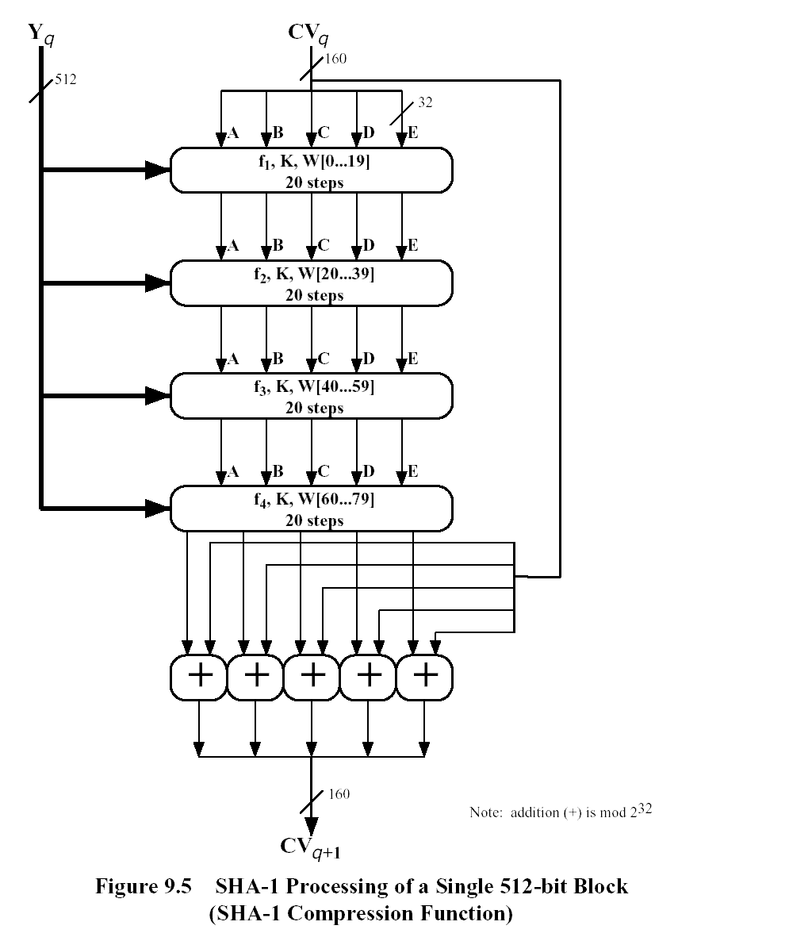

Slide 20
SHA-1 Compression Function
Each round has 20 steps which replaces the 5 buffer words thus:
  (A,B,C,D,E) <-(E+f(t,B,C,D)+(A<<5)+W_{t}+K_{t}),A,(B<<30),C,D)
a,b,c,d refer to the 4 words of the buffer
t is the step number
f(t,B,C,D) is nonlinear function for round
W_{t} is derived from the message block
K_{t} is a constant value derived from sin
Notes:
Can see SHA shares much in common with MD4/5, but with 20 instead of 16 steps in each of the 4 rounds. Note the 4 constants are based on sqrt(2,3,5,10). Note also that instead of just splitting the input block into 32-bit words and using them directly, SHA-1 shuffles and mixes them using rotates & XOR’s to form a more complex input, and greatly increases the difficulty of finding collisions.

Slide 21
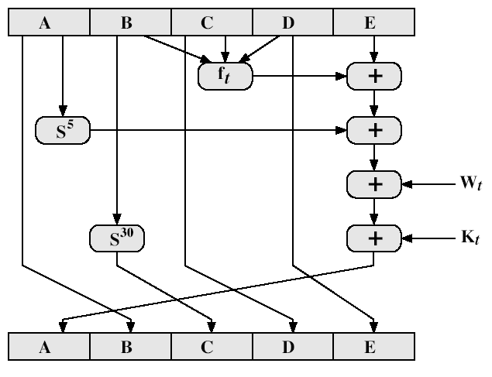
SHA-1 Compression Function

Slide 22
SHA-1 verses MD5
brute force attack is harder (160 vs 128 bits for MD5)
not vulnerable to any known attacks (compared to MD4/5)
a little slower than MD5 (80 vs 64 steps)
both designed as simple and compact
optimised for big endian CPU's (vs MD5 which is optimised for little endian CPU’s)
Notes:
Compare using the design goals listed earlier.
SHA-1 is probbaly the preferred hash function for new applications. Currently no problems are known with it.

Slide 23
SHA 512 Logic
Takes as input a msg with max length of less than 2¹²⁸bits
Produce as output a 512 bit msg digest
i/p is processed in 1024bit blocks

Slide 24
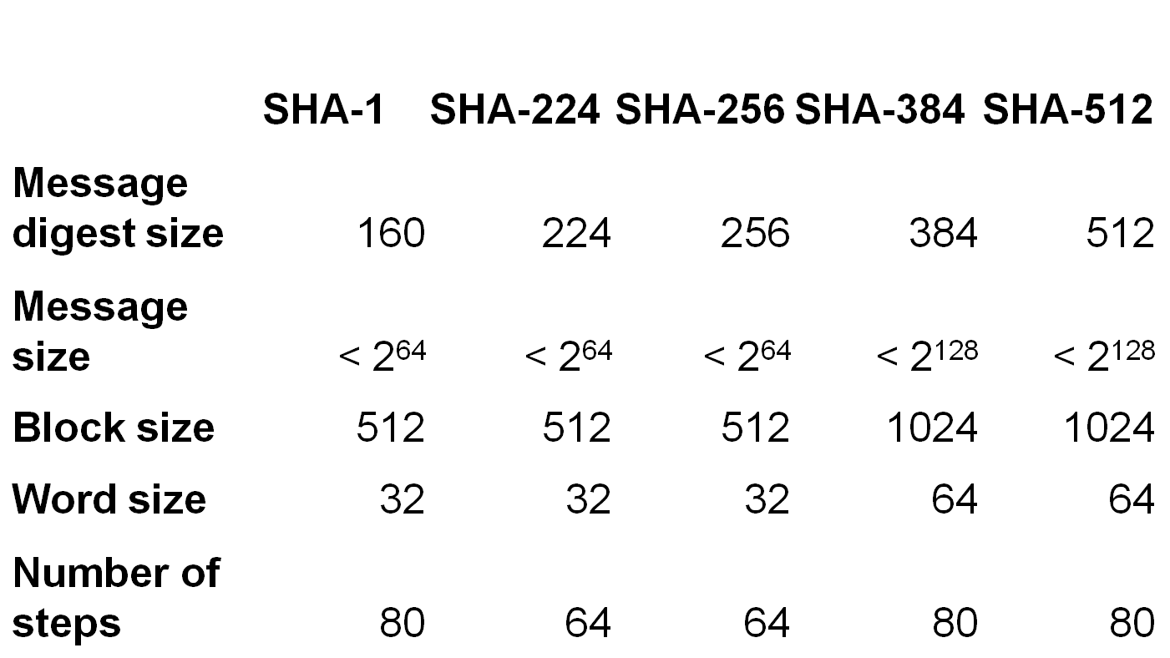
SHA Versions
Notes:
Stallings Table 11.3 provides a comparison of the various parameters for the SHA hash functions.

Slide 25
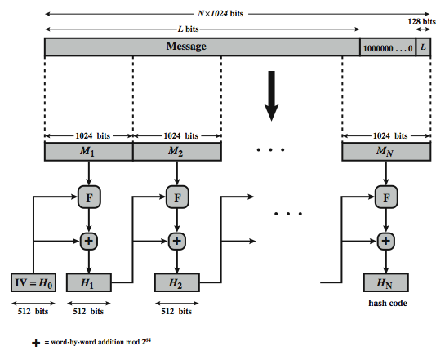

Slide 26
SHA 512 Overview
pad message so its length is 896modulo 1024
append a 128-bit length value to message
Initialize hash buffer
512 bit buffer used to hold intermediate and final results of hash fun(a,b,c,d,e,f,g,h),values are stored in big endian format
4. process message in 1024 bit(128 word) blocks:
  Algorithm consists of 80 rounds
Notes:
The padded message is broken into 512-bit blocks, processed along with the buffer value using 4 rounds, and the result added to the input buffer to make the new buffer value. Repeat till run out of message, and use final buffer value as hash. nb. due to padding always have a full final block (with length in it).

Slide 27
  Each round takes as input 512bit buffer value and updates the content of the buffer
  Each round uses an additive constant Kt,0<=t<=79 ,indicates one of the 80 rounds
  Output of the 80th round id added to the input to the first round to produce Hi
  5. After all N 1024 bit blocks have been processed ,the output from the Nth stage is the 512 bit digest

Slide 28

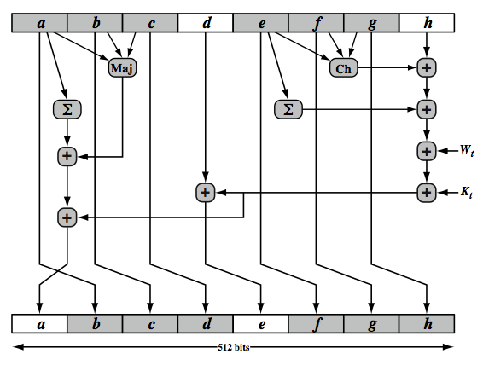
SHA-512 Round Function

